Slide 1
Where does our profit really come from?
MANAGEMENT BRIEFING · SALES PROFIT REVIEW
BY SUROMYA GHOSH DASTIDAR
Revenue has been flat for seven years. We studied 50,000 orders to find what actually moves profit.
$8.7B
29.5%
+0.3%
revenue a year, on average
profit margin overall
revenue growth a year, 2010 to 2016
50,000 orders · Jan 2010 to Jul 2017 · Dataset is synthetic, so findings describe this dataset
1 / 7
Notes:
Opening: revenue is about 8.7 billion dollars a year with a 29.5 percent margin, and it has not grown. The question for today: if we cannot count on volume growth, where can profit come from? Note up front that the dataset is a public practice dataset that its publisher says is randomly generated, so treat the findings as a method to repeat on real company data.

Slide 2
What we analysed and how
The data
How we checked it
How we analysed it
50,000 orders, Jan 2010 to Jul 2017
12 product categories
7 regions, 185 countries
Online and Offline sales
Revenue, cost and profit per order
No missing values or duplicates
Revenue, cost and profit tie out on every row
Dates fixed; 2017 flagged as a part year
Large orders kept, not deleted
Profit and margin by product, region, channel and priority
Trend and seasonality
Statistical tests on five hypotheses
What-if sizing of price and mix levers
Read with care: the publisher states this public dataset is randomly generated, not real sales. Treat the findings as a method to repeat on our own data.
Source: 50000 Sales Records, Excel BI Analytics · Dataset is synthetic
2 / 7
Notes:
Keep this plain. The data is 50,000 orders over seven and a half years. We confirmed it is internally consistent: revenue minus cost equals profit on every row, nothing is missing, nothing is duplicated. The one caution is on the slide: it is a practice dataset that was generated by a program, so every finding should be confirmed on real company data before money is moved.

Slide 3
Four things management should know
100%
34% → 19.5%
Product decides margin
Revenue misleads
Region, channel and priority explain under 0.01% of margin differences.
Office Supplies and Meat are 34% of revenue but only 19.5% of profit.
+0.3% a year
25.0 vs 24.9 days
The business is flat
Priority is not honoured
Average growth 2010 to 2016. The 44% fall shown for 2017 is only seven months of data.
Critical orders ship in 25.0 days on average, Low orders in 24.9.
Source: 50000 Sales Records, Excel BI Analytics · Dataset is synthetic
3 / 7
Notes:
One: what a product is decides its margin; where or how it is sold does not move it. Two: ranking by revenue would send attention to Office Supplies and Meat, which together earn far less profit than their sales suggest. Three: sales are flat, so growth has to come from mix, price or service. Four: orders marked Critical ship no faster than Low ones. The 2017 drop is an artefact of the data ending in July.

Slide 4
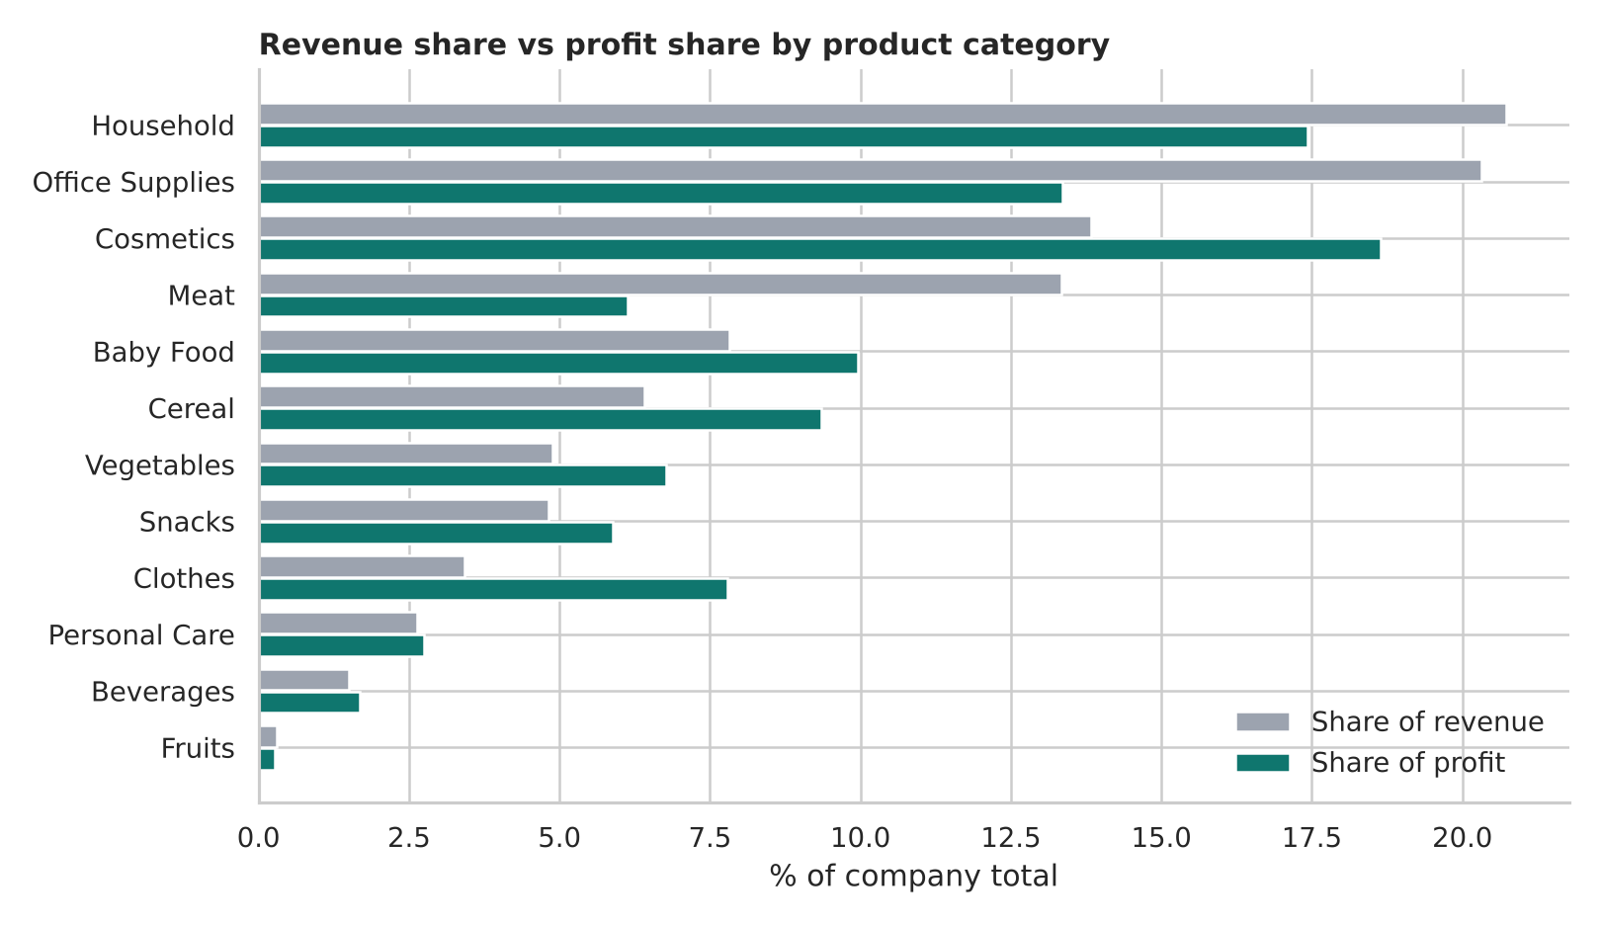
Revenue and profit tell different stories
Cosmetics
13.8% of revenue, 18.6% of profit. Our top profit category at a 39.8% margin.
Clothes
3.4% of revenue, 7.8% of profit. The highest margin in the range at 67.2%.
Meat
13.3% of revenue, 6.1% of profit. The lowest margin at 13.6%.
Grow what earns. Fix what only sells.
Source: 50000 Sales Records, Excel BI Analytics · Dataset is synthetic
4 / 7
Notes:
This is the single most important chart. Grey is each category's share of revenue, green is its share of profit. Where green is longer than grey, the category earns more than its sales suggest: Cosmetics, Clothes, Baby Food, Cereal. Where grey is longer, it earns less: Office Supplies, Meat, Household. Prices and costs in this dataset are fixed per category, so margin is a property of the product.

Slide 5
Three actions, in priority order
1
2
3
Review price and cost on Meat and Office Supplies
Shift the mix toward high-margin products
Make order priority mean something
Pilot a 2–3% price rise or a supplier cost deal in two regions, with matching regions as a control.
Promote Cosmetics, Clothes, Cereal and Baby Food to existing accounts. Set category profit targets.
Set shipping targets by priority and report them monthly, starting with the largest orders.
Owner: Pricing, Procurement
Owner: Commercial, Sales
Owner: Operations
Confirm each on real company data before acting · Dataset is synthetic
5 / 7
Notes:
Ranked by impact and ease. Pricing is first because it needs no new customers and can be piloted in a quarter. The mix shift is bigger in potential but depends on customers actually buying more of the high-margin products, so it needs a test. Priority targets are a process fix with mostly service benefits.

Slide 6
What success could look like
Action | Possible upside, if volume holds | How we would measure it
1. Price and cost | About $59M a year at +2%; $147M a year at +5% (5.7% of profit) | Margin on Meat (13.6%) and Office Supplies (19.4%); volume against control regions
2. Mix shift | About $85M a year if 10% of Office Supplies sales moved to Clothes | Profit share of the four target categories (now 46%); overall margin (now 29.5%)
3. Priority targets | Protects the 8.5% of orders that earn 28.5% of profit | Average days to ship by priority; share of Critical orders on time
A 5% price rise on both categories still pays off unless volume falls by more than 27% (Meat) or 21% (Office Supplies). These are arithmetic sizings, not forecasts.
Source: analysis of 50000 Sales Records · Dataset is synthetic
6 / 7
Notes:
Dollar figures are what the same lever would have added per year across the 7.6 years in the data. They assume customers keep buying at the new price or mix, which this dataset cannot tell us, so they are upper-bound arithmetic. The break-even line is the useful number: price rises of 5 percent are still profitable unless volume drops by more than about a quarter.

Slide 7
Be careful about this, then do this next
Be cautious
Analyse next
The data is randomly generated, so real markets may behave differently.
Price and cost never vary within a product, so we cannot tell how customers react to price.
2017 stops in July, so growth rates use 2010 to 2016.
No customer, discount or return data.
Repeat this analysis on real company sales.
Add customer and discount data to test price response.
Pull actual shipping targets and delays by priority.
Run the price pilot and mix test before any wider rollout.
Source: analysis of 50000 Sales Records · Dataset is synthetic
7 / 7
Notes:
One conclusion we cannot draw: that raising prices will raise profit in practice. Price is fixed within each product in this file, so there is no evidence on how volume reacts. That is why the first recommendation is a pilot, not a rollout.

